Slide 1
HACKATHON PROJECT • PS-04
GrammarFix
Dangling-Else Resolver
Detecting grammar ambiguity and resolving nested if–else statements through matched and unmatched grammar rules.
Python • Streamlit • Parse Trees
2026

Slide 2
The Problem: Dangling Else
Why nested conditional statements can be ambiguous
Example input
The ambiguity
if (a)
if (b)
x;
else
y;
Does else belong to the inner if (b)?
Or does it belong to the outer if (a)?
The original grammar can permit both parse structures.
Goal: detect ambiguity, then show the intended parse.
2

Slide 3
Project Objectives
What GrammarFix is designed to demonstrate
01
Accept input
Read nested if statements with optional else clauses.
02
Detect ambiguity
Find multiple valid parse trees under the original grammar.
03
Transform grammar
Use matched and unmatched statement productions.
04
Compare parse trees
Show competing interpretations and the transformed result.
05
Explain the rule
Demonstrate nearest-unmatched-if association.
3

Slide 4
Grammar Before and After
Original grammar vs. matched/unmatched formulation
Original ambiguous grammar
Transformed grammar (conceptual)
S → if (E) S
S → if (E) S else S
S → other
S → M | U
M → if (E) M else M | other
U → if (E) S | if (E) M else U
An if may be parsed with or without else.
Some strings therefore have multiple parse trees.
M = matched statement; U = unmatched statement.
The grammar encodes nearest-unmatched-if behavior.
4

Slide 5
How GrammarFix Works
Processing pipeline from source input to explanation
1
2
3
4
5
Input
Tokenize
Parse original
Resolve
Explain
User enters nested if–else code
Split source into tokens
Enumerate valid parse trees
Parse with transformed rules
Compare results and show binding
Result: the user can compare ambiguity in the original grammar with the single intended interpretation.
5

Slide 6
Two Possible Interpretations
For the classic dangling-else input
if (a) if (b) x; else y;
Parse A: else → inner if
Parse B: else → outer if
Nearest unmatched if
Alternative original parse
IF (a)
└─ THEN: IF (b)
├─ THEN: x;
└─ ELSE: y;
IF (a)
├─ THEN: IF (b)
│ └─ THEN: x;
└─ ELSE: y;
The transformed grammar retains the intended nearest-unmatched-if interpretation.
6

Slide 7
Resolution: Nearest Unmatched If
How the transformed grammar disambiguates the input
An if is unmatched when it has no associated else.
When an else can attach to the most recent unmatched if, it is attached there.
Matched and unmatched productions restrict valid structures.
For the example, else is attached to if (b).
Resolved parse tree
IF (a)
THEN
IF (b)
THEN: x;
ELSE: y;
The else is part of the inner if (b), not the outer if (a).
7

Slide 8
Test Cases
Representative inputs for demonstrating the resolver
1. Classic ambiguity
if (a) if (b) x; else y;
Original: 2 parses; transformed: 1
2. No else
if (a) if (b) x;
One parse; no dangling else
3. Two else clauses
if (a) if (b) x; else y; else z;
One fully matched interpretation
4. Simple statement
x;
One parse
5. Three levels
if (a) if (b) if (c) x; else y;
Multiple original parses; one transformed parse
8

Slide 9
Technology and Project Structure
A lightweight local application built for a hackathon demo
Technology stack
Project files
Python — parsing and tree data structures
Streamlit — interactive browser-based UI
unittest — automated checks
Graphviz package may support future graphical tree rendering
GrammarFix/
├── app.py
├── core_logic.py
├── test_core_logic.py
├── requirements.txt
└── README.md
Design principle: keep parsing logic separate from the user interface so it can be tested independently.
9

Slide 10
Run the Project in VS Code
Windows PowerShell commands
python -m venv .venv
.\.venv\Scripts\Activate.ps1
python -m pip install -r requirements.txt
python -m unittest discover -s . -p "test_*.py" -v
python -m streamlit run app.py
Open the localhost address shown in the terminal.
Load the classic example and click Resolve Ambiguity.
Show the original parse count, transformed parse, and explanation.
10

Slide 11
Limitations and Future Enhancements
Be clear about the current prototype scope
Current prototype scope
Future enhancements
Supports a restricted educational syntax.
Not a full C, Java, or Python parser.
Tree output may be textual or nested JSON unless graphical rendering is added.
Automated tests should be run before a live demo.
Interactive graphical parse trees.
Adjustable nesting depth and generated test cases.
Highlight the exact if that owns each else.
Export parse trees and test results.
A strong demo combines correct parsing, clear visualization, and an understandable explanation.
11

Slide 12
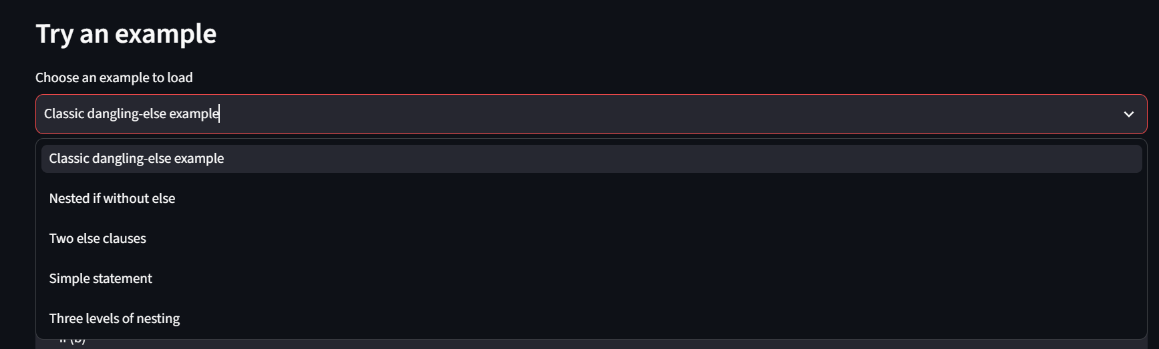
Result

Slide 13
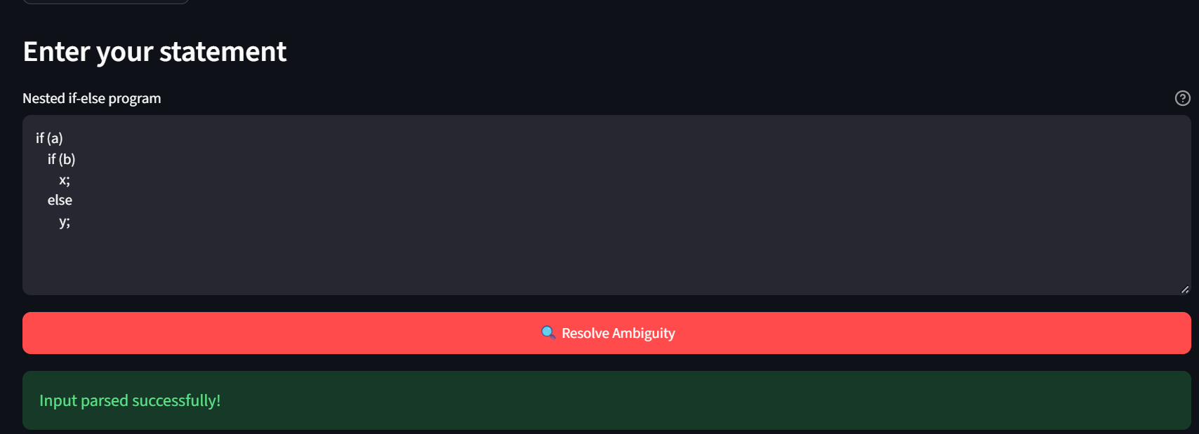
Result

Slide 14
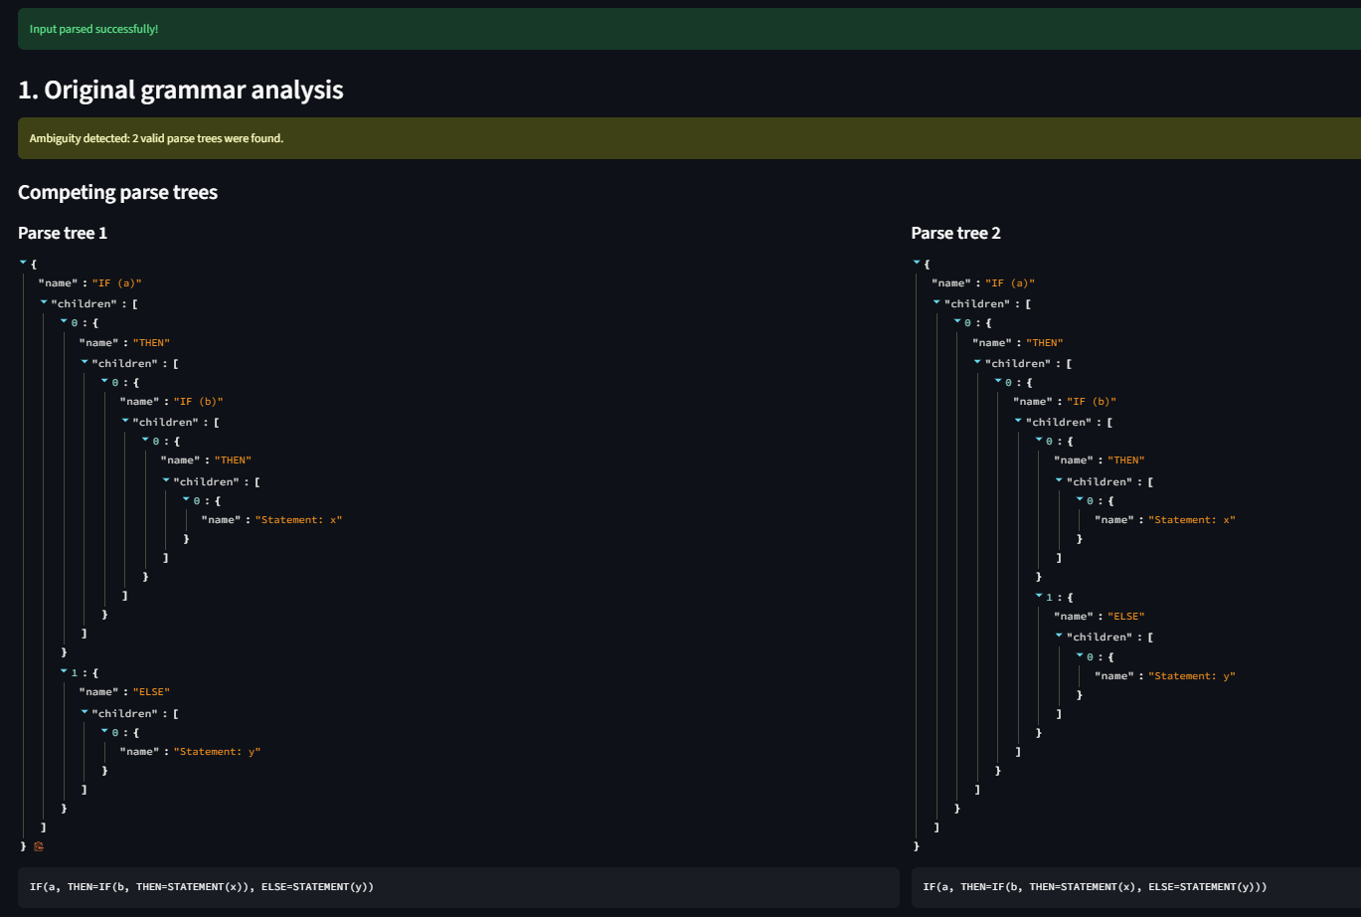
Result

Slide 15
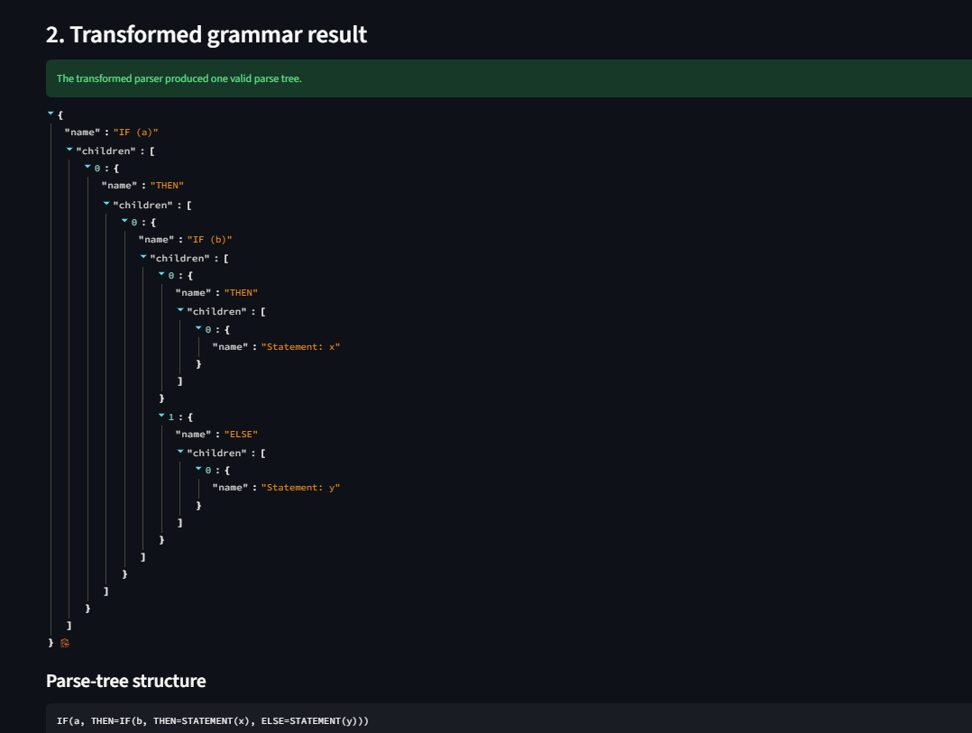
Result

Slide 16
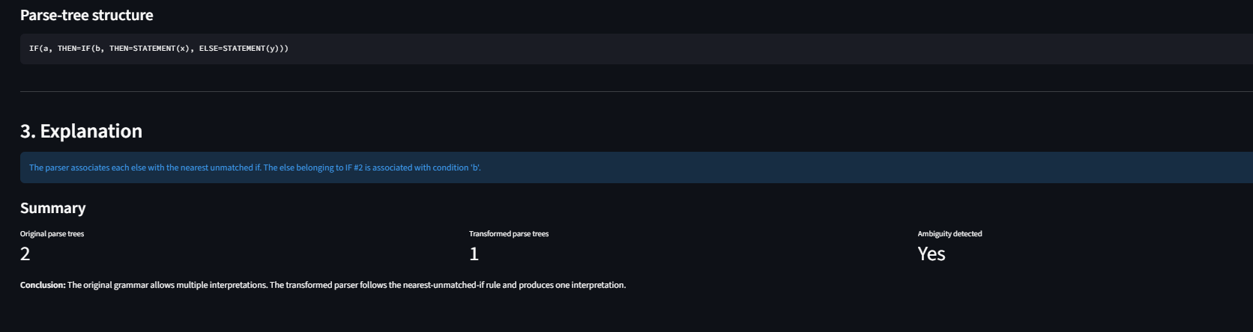
Result

Slide 17
Conclusion
GrammarFix demonstrates how grammar ambiguity can be identified and resolved using matched and unmatched statement rules.
The original grammar may admit more than one parse tree.
The transformed grammar encodes the nearest-unmatched-if rule.
The application makes the parsing behavior visible and testable.

